Slide 1
INTermediate Arduino Workshop

Slide 2
Today’s Teaching Team
Dr. Nancy Nelson
Engineering IDEAs Clinic
IDEAs Clinic Co-ops:
Hailey, Fareed, Owen, Ian, Kai, Fuzail

Slide 3
Polling, interrupts and time Functions

Slide 4
Interrupts & Polling
Interrupts are events that invoke a function to be executed immediately superseding typical functionality.
Polling is the continuous checking of a device, state, or condition to see if action needs to be taken or data is ready

Slide 5
Time functions
Arduino's have built in functions to abstract the hardware timer functionality. These can be used to simply implement a timer, or stopwatch, etc...
Main function you will use: millis()
  Returns an integer of the number of milliseconds that have passed since the Arduino started up.

Slide 6
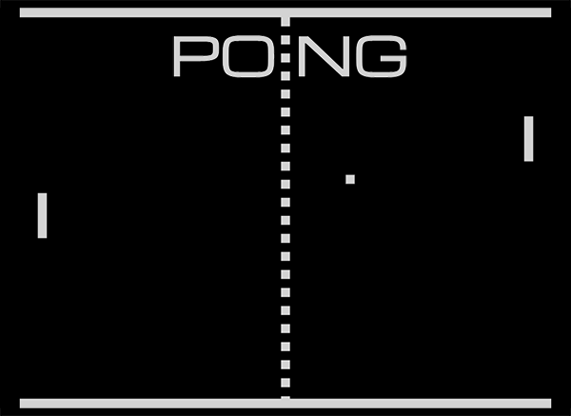
Your goal: write a Pong game

